Slide 1

Project Stage-II Presentation on Design and Development of Digital Water Flow Meter
Presented by, Under the guidance of
Atul Gaikwad
Pradip Borade
Pranali Bendale Mr. V. B. Gawai
Department of Electronics & Telecommunication

Slide 2
Contents
Aim and Objective
Introduction
Literature review
Block Diagram
Circuit Diagram
Power Supply Design
Advantages
Applications
References
Aim and Objective
Introduction
Literature review
Block Diagram
Circuit Diagram
Power Supply Design
Advantages
Applications
References

Slide 3
Aim:
To Design and Development of Digital Water Flow meter.
Objectives:
The main objective of this project is to create a cost efficient digital water flow meter.
To support “Make in India” concept by Developing flow meter.
Design and Development of Digital Water Flow Meter

Slide 4
Introduction
Flow measurement is the quantification of bulk fluid movement.
Depending on the application flow rate is measured as volume or mass.
This system can clamp onto a pipe and measure flow with type of sensor placed inside the pipe , allowing fluid to pass through their bodies as it measure .
Among the various types of flow meters , digital flow meter are most commonly used because of precise and accurate.
This system depends on the hall effect sensor
It is turbine type flow meter.
Design and Development of Digital Water Flow Meter

Slide 5
Literature Survey
Sr.no | Published in Year | Name of the Paper | Method | Results
3. | ISSE 2006 | Ultrasonic Flow meter | To measure flow using ultra sonic waves | The module contains low cost
4. | AIEE2011 (J.H.LAUB) | An Electric Flow meter | Electronic Principle | Watt meter is used to indicate and record the rate of flow and a watt-meter to register the total flow.

Slide 6
What type of flow meter is best?
There are no “universal” flow meters which are suitable for all applications.
Things you must know:
What is the Gas or Liquid being measured?
Minimum and maximum flow rates.
What are the accuracy requirements?
The fluid temperature and viscosity.
Fluid compatibility with the materials of construction (See our materials compatibility guide)

Slide 7
The maximum pressure at the location.
What pressure drop is allowable?
Is the meter mounted in a hazardous location where explosive gases may be present?
Is the fluid flow continuous or intermittent?
What type of output signal or readout do you need?

Slide 8
Why do we need a precision flow meter?
You might not! Precision flow meters are used to provide accurate monitoring and/or flow control.
Some industrial applications require precise calculation of quantity, such as precision servo-valve development for the aerospace industry.
On the other hand, an application to measure water flow to a vineyard may only require a measurement accuracy of 5% to 10%.

Slide 9
TANK
POWER
SUPPLY
MCU
RUN
STOP
FILTER
PUMP CONTROL
FLOW METER / SENSOR
OUTPUT (APPLICATION)
LCD DISPLAY
Fig. BLOCK DIAGRAM OF DIGITAL FLOW METER

Slide 10
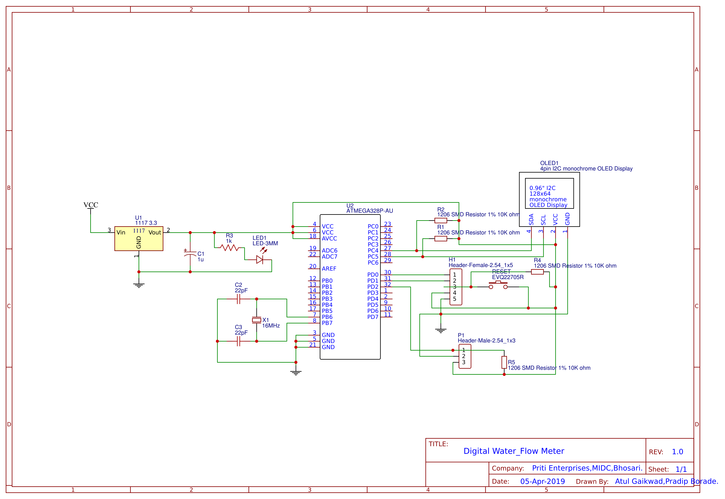

Slide 11
START
ENTER THE REQUIRED AMOUNT OF LIQUIED
PRESS THE RESET BUTTON
WATER STARTS FLOWING FROM PUMP
WATER PASSES THROUGH SENSOR
SENSOR KEEPS ON SHOWING FLOW RATE ON LCD
TIME= ENTERED TIME
PUMP AUTOMATICALLY GETS OFF
STOP

Slide 12
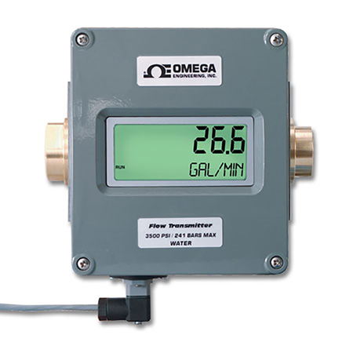
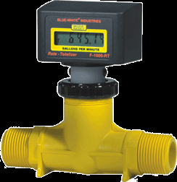
AVAILABLE RELATED PRODUCTS

Slide 13
Selection of sensor
Hall Effect Sensor
A Hall effect sensor is a transducer that varies its output voltage in response to a magnetic field. Hall effect sensors are used for proximity switching, positioning, speed detection, and current sensing applications.
Hall sensors are commonly used to time the speed of wheels and shafts, such as for internal combustion engine ignition timing, tachometers and anti-lock braking systems.

Slide 17
The basic relationship for determining the liquid’s flow
Q=V*A
Q=Flow rate/Total flow of water through the pipe
V=Average velocity of the flow
A=Cross-sectional area of the pipe.

Slide 19
Advantages
It is more reliable compare to traditional mechanical flow meters such as Rota meter.
It is easier to read due to availability of numerical display.
It is more accurate.
It relies less on pressure /temperature of fluid due to use of external power.

Slide 20
APPLICATONS:
Agriculture water flow monitoring
Small scale industries
Domestic applications
Building automation
Chemical
Food & Bevereges
Power & Utilities
Marine
Metals & Mining
Oil & Gas
Pharmaceutical
Pulp & Paper
Water & Wastewater

Slide 21
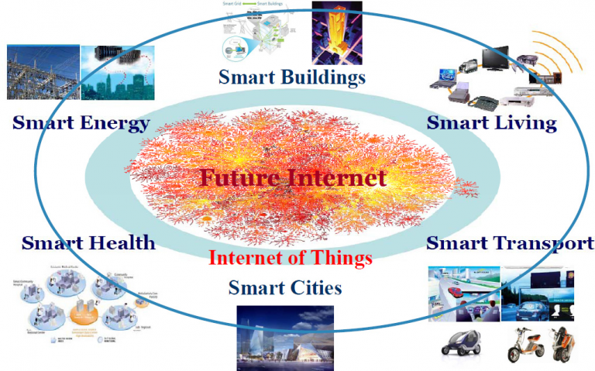
Scope of subject (1)

Slide 22
Thank You !!!

